Slide 1
How to USE
Dev Assistant Slash Commands: To frame your query, use slash commands. They’re like ready-made prompt templates. Use them as-is or add details to get more specific responses. Type ‘/’ to see a list of available commands. After you get a response, keep chatting to increase the response accuracy.
Command | Prompt Description
/explain | Explain the code in the active editor.
/test | Generate a test case.
/document | Generate documentation for the given code block in the default documentation scheme for the current file's programming language.

Slide 2
Effective Prompt Writing
Part of Prompt | Description | Example
Action | The task you want the AI to accomplish. | Create an Apex batch class named OpenPositionMatcher
Context details | Information about the context you want the AI to use. This includes important context such as org metadata and awareness about the presence of Salesforce objects and fields in your org. Run SFDX: Refresh SObjects Definitions to retrieve org metadata into your project. You can then add Salesforce Objects to your existing query. | Create an Apex batch class named OpenPositionMatcher that processes Position__c records created within the past 15 days. The class should match these open positions with suitable candidates based on their skills.
Best practices | Details about best practices you want the AI to follow such as security and formatting best practices. | Create an Apex batch class named OpenPositionMatcher that processes custom objects Position__c records created within the past 15 days. The class aims to match these open positions with suitable candidates based on their skills. Order the results by candidate names in descending order. Make sure the generated code follows security best practices. Separate operators with a new line.
Additional context | Any additional information that you want to provide. | Create an Apex batch class named OpenPositionMatcher that processes custom objects Position__c records created within the past 15 days. The class should match these open positions with suitable candidates based on their skills. Order the results by candidate names in descending order. Make sure the generated code follows security best practices. Separate operators with a new line. The class is used in an LWC component.

Slide 3
Effective Prompt Writing
Part of Prompt | Description | Example
Action | The task you want the AI to accomplish. | Create an Apex batch class named OpenPositionMatcher
Context details | Information about the context you want the AI to use. This includes important context such as org metadata and awareness about the presence of Salesforce objects and fields in your org. Run SFDX: Refresh SObjects Definitions to retrieve org metadata into your project. You can then add Salesforce Objects to your existing query. | Create an Apex batch class named OpenPositionMatcher that processes Position__c records created within the past 15 days. The class should match these open positions with suitable candidates based on their skills.
Best practices | Details about best practices you want the AI to follow such as security and formatting best practices. | Create an Apex batch class named OpenPositionMatcher that processes custom objects Position__c records created within the past 15 days. The class aims to match these open positions with suitable candidates based on their skills. Order the results by candidate names in descending order. Make sure the generated code follows security best practices. Separate operators with a new line.
Additional context | Any additional information that you want to provide. | Create an Apex batch class named OpenPositionMatcher that processes custom objects Position__c records created within the past 15 days. The class should match these open positions with suitable candidates based on their skills. Order the results by candidate names in descending order. Make sure the generated code follows security best practices. Separate operators with a new line. The class is used in an LWC component.

Slide 4
Effective Prompt Writing
Part of Prompt | Description | Example
Action | The task you want the AI to accomplish. | Create an Apex batch class named OpenPositionMatcher
Context details | Information about the context you want the AI to use. This includes important context such as org metadata and awareness about the presence of Salesforce objects and fields in your org. Run SFDX: Refresh SObjects Definitions to retrieve org metadata into your project. You can then add Salesforce Objects to your existing query. | Create an Apex batch class named OpenPositionMatcher that processes Position__c records created within the past 15 days. The class should match these open positions with suitable candidates based on their skills.
Best practices | Details about best practices you want the AI to follow such as security and formatting best practices. | Create an Apex batch class named OpenPositionMatcher that processes custom objects Position__c records created within the past 15 days. The class aims to match these open positions with suitable candidates based on their skills. Order the results by candidate names in descending order. Make sure the generated code follows security best practices. Separate operators with a new line.
Additional context | Any additional information that you want to provide. | Create an Apex batch class named OpenPositionMatcher that processes custom objects Position__c records created within the past 15 days. The class should match these open positions with suitable candidates based on their skills. Order the results by candidate names in descending order. Make sure the generated code follows security best practices. Separate operators with a new line. The class is used in an LWC component.

Slide 5
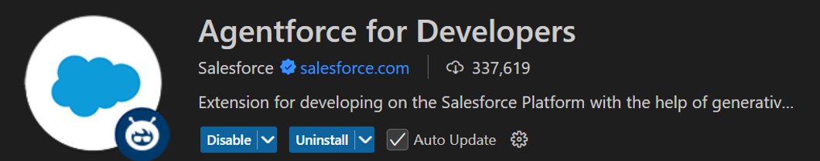
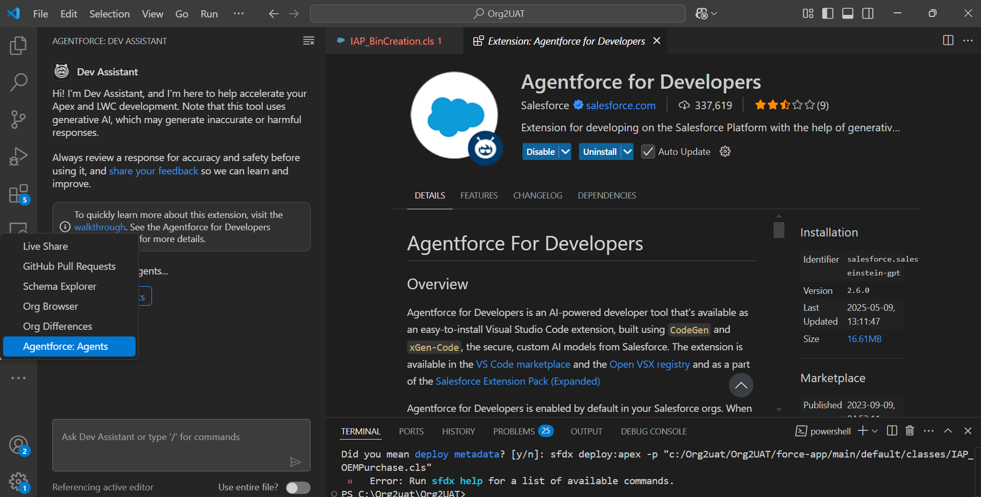
Agent force for Developers Extension
Extension Will be Available as per the Screen Shot, Chat with Dev Assistant

Slide 6
Prompt Library
Prompt | Prompt Example
Generate/modify the “Class Name” for “Method Name” to add a condition specific to criteria. Generate/modify the “Method Name” in “Class Name” to add a condition specific to criteria. | 1) Generate/Modify the “ IAP_BinCreation” in method “checkandUpdateBinLocation2” to update the inventory only for logged in user country = india. 2) Change the method (handleAfterAssetInsert) in Class “ IAP_AssetTriggerHandler” to add a field on IAP_Service_Reminder__c with Field name 'Name' = 'Test Japan' with the condition only if the logged in user country= 'Japan’.
Generate an Apex class with Action, Context details, Best practices and Additional context. Refer the above Slide in details | Create an Apex batch class named OpenPositionMatcher that processes custom objects Position__c records created within the past 15 days. The class should match these open positions with suitable candidates based on their skills. Order the results by candidate names in descending order. Make sure the generated code follows security best practices. Separate operators with a new line. The class is used in an LWC component
Generate an Apex with LWC component to generate the user story details | Create a LWC component and Apex class to generate a custom list view with the following field from case with respect to Asset id system should show, all the records of the VIN as ' Case History' . Section Field Name Remarks List view Line Items Validation: From 1 . incremental number . Case Number Fetch from case object . Case Status Fetch from case object . Date Opened Fetch from case object Date Closed Fetch from case object Date Reopened Fetch from case object . Subject Fetch from case object . Case Category Fetch from case object . Case Type Fetch from case object

Slide 7
Prompt Library
Prompt Library
Prompt Format/Usage case | Prompt Example
Please rewrite the trigger/class to use the handler class. Specify the comments and generate test class | Please rewrite this trigger to be bulkified and to use a handler. Add lots of comments including a standard header block. And write positive and negative test classes.
Convert a Visualforce page to LWC with Comments/documentation | Please convert the VF page to LWC . Please create a Java script and Html files with clear comments.
Generate LWC components and Communicate between them and Generate the class and test classes with best practices. | Write one or multiple LWC components and apex classes for the below requirement: First LWC component will display the list of accounts and after clicking any of the account it will display only that account details in a separate component. All the LWC components should communicate with each other in app page using Lightning Message Service. Pl. help with the salesforce development.
Scenario based logic Generation | Display the list of accounts with pagination where the related opportunity stages are closed won and has at least one contact with valid email address. This should implement with LWC.
Generate Test class/Code Coverage improvement | Please create test class for above handler code and maintain with 80% of code coverage.

Slide 8
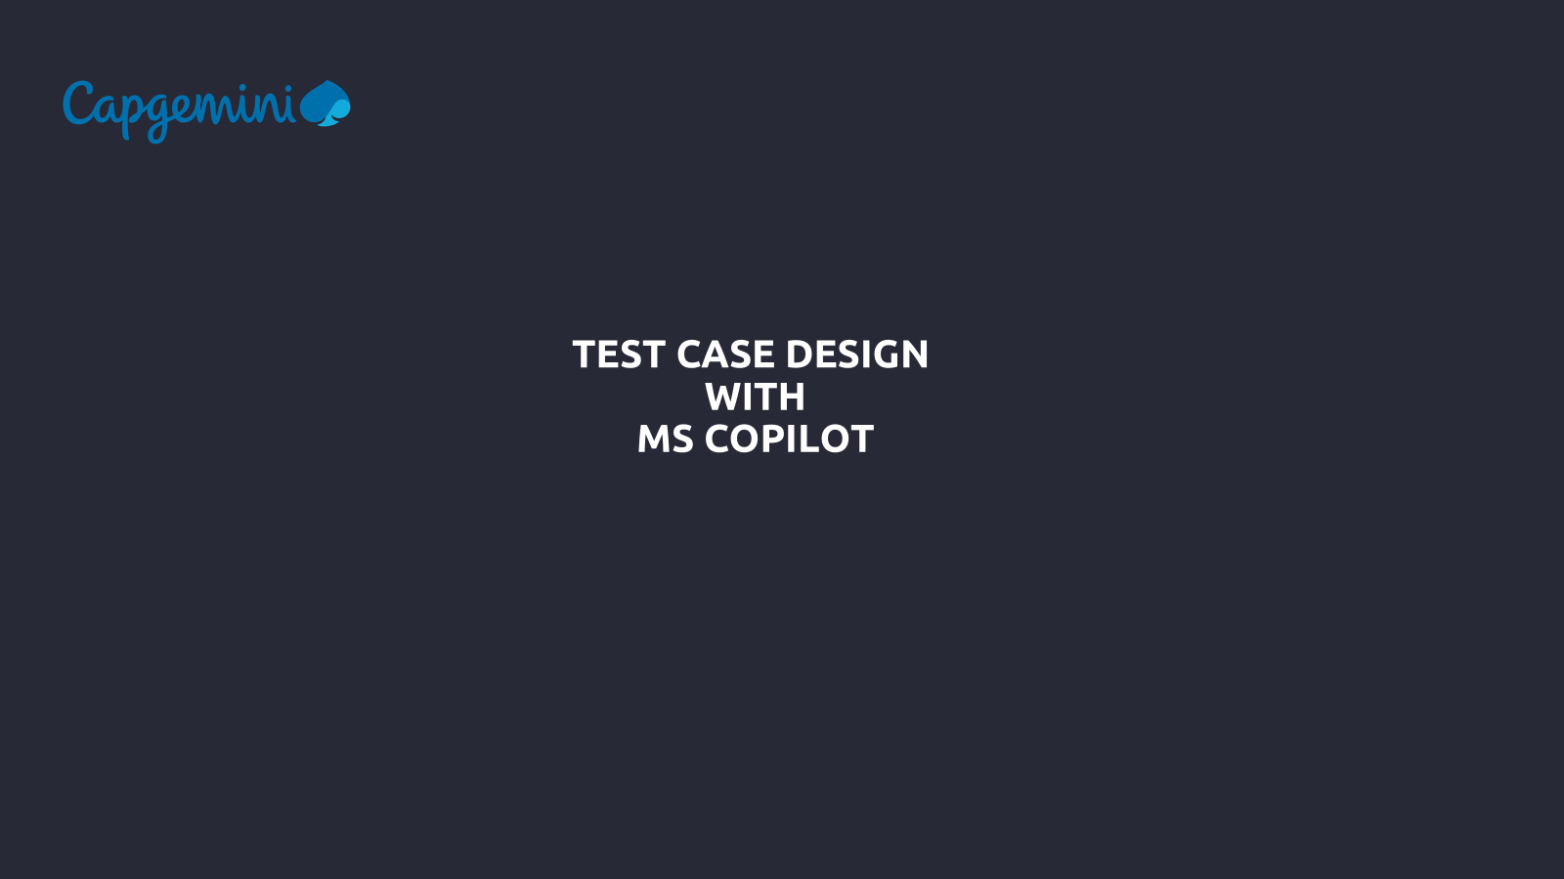
Prompt Library for Salesforce
1) Change the method (checkandUpdateBinLocation2) in class “ IAP_BinCreation” to update the inventory only for logged in user country = india
2) Change the method (handleAfterAssetInsert) in Class “ IAP_AssetTriggerHandler” to add a field on IAP_Service_Reminder__c with Field name 'Name' = 'Test Japan' with the condition only if the logged in user country= 'Japan’.
3) Modify the 'Search Orders' method in Class “ IAP_OEMPurchase” to add and additional field in the query with created date.
4) IAP_AFS_SoRoCreateFromAssetController class with the method name checkSO to handle WorkOrder checks with RelatedAccounts instead of Accounts directly. Here's the updated code:
5) Modify or Add the logic in the class "IAP_CreateAssetAPI" for the method "createAsset" to read the request body and add a condition to verify the string of asset.IAP_Sold_by_dealer__C = 'Dummy dealer" through a error response back with message ('Dummy Dealer’).
6) Modify or Add the logic in the class "IAP_CreateAssetAPI" for the method "createAsset" to read the request body and add a condition to verify the string of asset.IAP_Sold_by_dealer__C = 'Dummy dealer" through a error response back with message ('Dummy Dealer') and inser the account only if the Account.IAP_Country='Japan' else do not insert the account and contact.
7) Create a LWC component and Apex class to generate a custom list view with the following fielda from cas with respect to Asset id system should show, all the records of the VIN as ' Case History' . Section Field Name Remarks List view Line Items Validation: From 1 . incremental number . Case Number Fetch from case object . Case Status Fetch from case object . Date Opened Fetch from case object Date Closed Fetch from case object Date Reopened Fetch from case object . Subject Fetch from case object . Case Category Fetch from case object . Case Type Fetch from case object

Slide 9

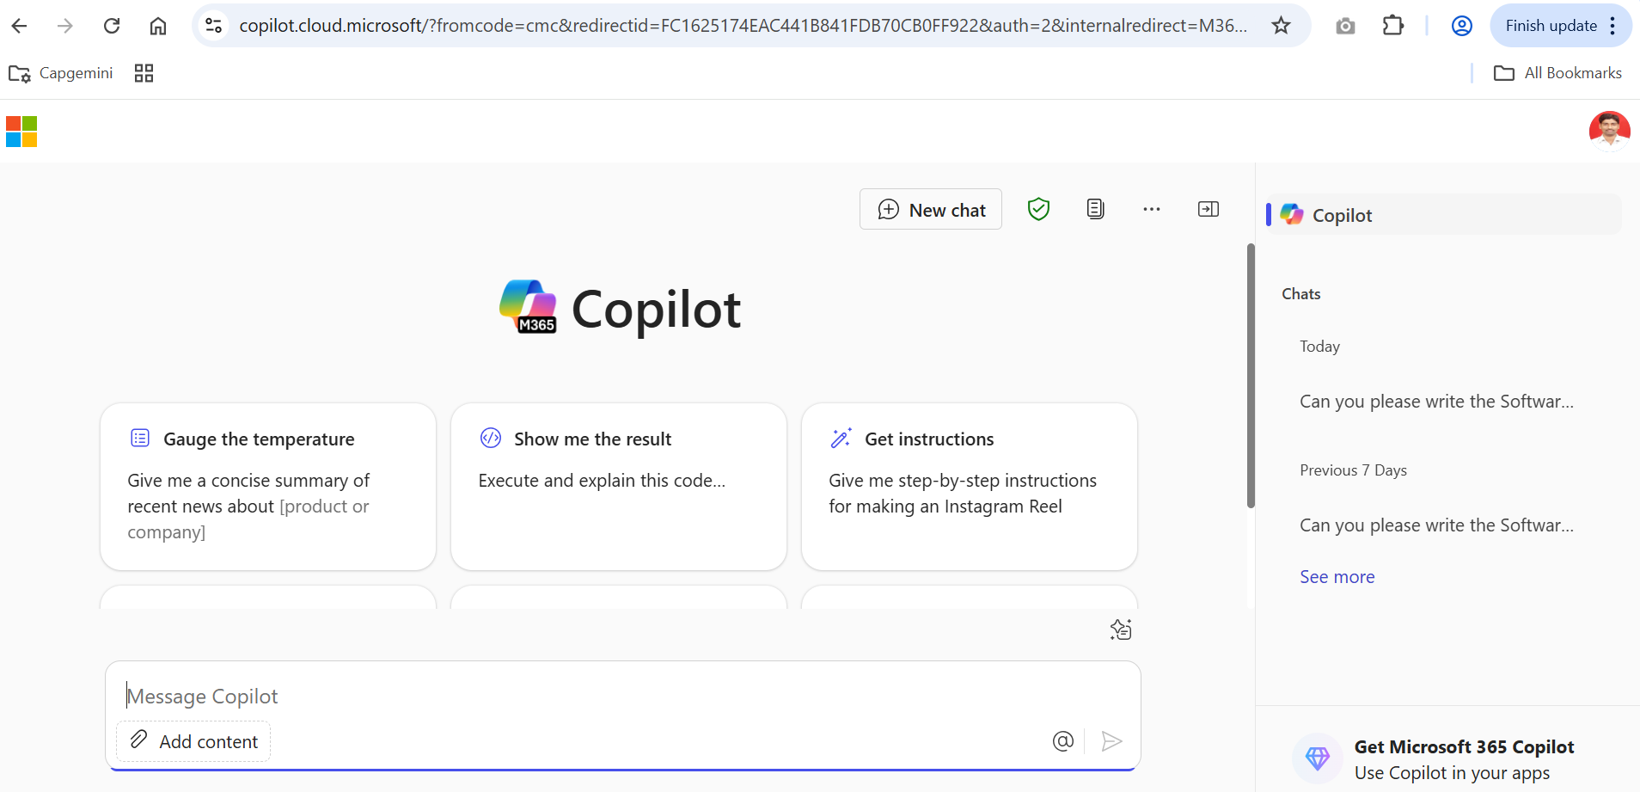
Microsoft copilot
URL to Use : https://copilot.microsoft.com/

Slide 10
Microsoft copilot
Sample Prompt for Test Case Design :
Can you please write the Software testing test cases for below user story with negative and positive cases in Excel format with columns Test Case ID, Test Scenario, Test Script, Test Steps, Expected Result, Actual Result, Pass/Fail, Test Data and Comments.
<Acceptance Criteria of Your User Story>

Slide 11
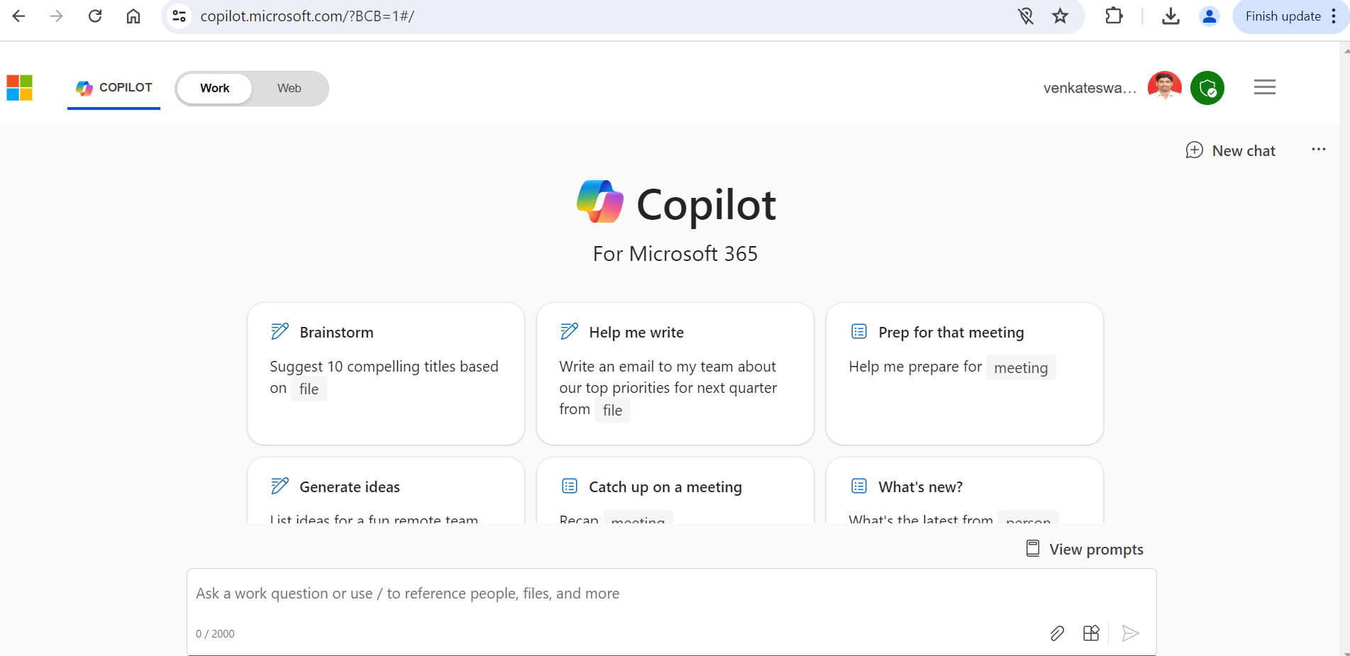
Test case design for Validation rule - prompt
Prompt : Can you please write the Software testing test cases for below user story with negative and positive cases in Excel format with columns Test Case ID, Test Script, Test Steps, Expected Result, Actual Result, Pass/Fail, Test Data and Comments.
1. Given user cannot bypass the Validation rules, Navigate to App [-----]->Sales Opportunities->Create/Update of Opportunity [KAL CRM, Komatsu Construction, New Opportunity, Lost Order] AND Type is Equals "Services" AND Subtype is Not Blank AND Service Sub Category is Blank AND Record Type NOT Equals "Montabert" When the Opportunity is saved Then the Error message 'If Opportunity Type = Service, then Service Sub Category is required.' should be displayed and Opportunity should not be saved.

Slide 12
Test case design for Validation rule – Prompt results
Results :
Test Case ID | Test Script | Test Steps | Expected Result | Actual Result | Pass/Fail | Test Data | Comments
TC001 | Verify validation rule for Service Type without Sub Category | 1. Navigate to App -> Sales Opportunities -> Create/Update of Opportunity [KAL CRM, Komatsu Construction, New Opportunity, Lost Order] <br> 2. Select Type as "Services" <br> 3. Leave Subtype as Not Blank <br> 4. Leave Service Sub Category as Blank <br> 5. Attempt to save the Opportunity | Error message 'If Opportunity Type = Service, then Service Sub Category is required.' is displayed. Opportunity is not saved. | To be filled after execution | To be filled after execution | Type: Services, Subtype: Not Blank, Service Sub Category: Blank | Positive Test Case
TC002 | Verify validation rule bypass with Record Type "Montabert" | 1. Navigate to App -> Sales Opportunities -> Create/Update of Opportunity [KAL CRM, Komatsu Construction, New Opportunity, Lost Order] <br> 2. Select Type as "Services" <br> 3. Leave Subtype as Not Blank <br> 4. Leave Service Sub Category as Blank <br> 5. Select Record Type as "Montabert" <br> 6. Attempt to save the Opportunity | No error message is displayed. Opportunity is saved. | To be filled after execution | To be filled after execution | Type: Services, Subtype: Not Blank, Service Sub Category: Blank, Record Type: Montabert | Negative Test Case

Slide 13
Test case design for SHARING RULE - prompt
Prompt : Can you please write the Software testing test cases for below user story with negative and positive cases in Excel format with columns Test Case ID, Test Script, Test Steps, Expected Result, Actual Result, Pass/Fail, Test Data and Comments.
1. Given user belong to Group: Africa All Users,
Navigate to App [-----]->Accounts->Sales opportunities-> Select an existing opportunity with region equals Africa
1. User within this group should be able to view the opportunity records
2. User within this group should not be able to modify the opportunity records
3. Opportunities outside the Africa region should not be affected by this sharing rule

Slide 14
Test case design for SHARING rule – Prompt results
Results :
Test Case ID | Test Script | Test Steps | Expected Result | Actual Result | Pass/Fail | Test Data | Comments
TC001 | Verify view access for Africa group | 1. Navigate to App -> Accounts -> Sales opportunities. 2. Select an existing opportunity with region equals Africa. | User should be able to view the opportunity records. | To be filled after test execution | To be filled after test execution | Group: Africa All Users, Region: Africa | Positive Test Case
TC002 | Verify modification restriction for Africa group | 1. Navigate to App -> Accounts -> Sales opportunities. 2. Select an existing opportunity with region equals Africa. 3. Attempt to modify the opportunity records. | User should not be able to modify the opportunity records. | To be filled after test execution | To be filled after test execution | Group: Africa All Users, Region: Africa | Positive Test Case
TC003 | Verify unaffected opportunities outside Africa | 1. Navigate to App -> Accounts -> Sales opportunities. 2. Select an existing opportunity with region not equals Africa. | Opportunities outside the Africa region should not be affected by this sharing rule. | To be filled after test execution | To be filled after test execution | Group: Africa All Users, Region: [Not Africa] | Negative Test Case

Slide 15
Test case design for WORKFLOW - prompt
Prompt : Can you please write the Software testing test cases for below user story with negative and positive cases in Excel format with columns Test Case ID, Test Script, Test Steps, Expected Result, Actual Result, Pass/Fail, Test Data and Comments.
1. Given the user selects Sales & Lightning App > Case >
when the user Clicks on New> select Machine/Component Failure
And Sales Organization of Account is PCA1
when the case is saved
Then an email should be sent out to Kamyar Hodjati​
and From Email Address - No-Reply Komatsu CRM" salesforce-nagm@global.komatsu​
And case is created

Slide 16
Test case design for WORKFLOW – Prompt results
Results :
Test Case ID | Test Script | Test Steps | Expected Result | Actual Result | Pass/Fail | Test Data | Comments
TC001 | Verify email sent to Kamyar Hodjati on case creation | 1. Select Sales & Lightning App > Case. 2. Click on New > select Machine/Component Failure. 3. Ensure Sales Organization of Account is PCA1. 4. Save the case. | An email should be sent to Kamyar Hodjati from No-Reply Komatsu CRM. | To be filled after execution. | To be filled after execution. | Account Sales Organization: PCA1 | Positive test case to verify email functionality.
TC002 | Verify case creation with valid data | 1. Select Sales & Lightning App > Case. 2. Click on New > select Machine/Component Failure. 3. Enter valid Sales Organization of Account. 4. Save the case. | A new case should be created successfully. | To be filled after execution. | To be filled after execution. | Account Sales Organization: PCA1 | Positive test case to verify case creation.
TC003 | Verify no email sent when Sales Organization is not PCA1 | 1. Select Sales & Lightning App > Case. 2. Click on New > select Machine/Component Failure. 3. Enter Sales Organization of Account other than PCA1. 4. Save the case. | No email should be sent to Kamyar Hodjati. | To be filled after execution. | To be filled after execution. | Account Sales Organization: XYZ1 | Negative test case to verify email is not sent for other Sales Organizations.

Slide 17
Points to BE note when ms copilot using
Accuracy depends on the proper user story creation
Always choose Work option in the tab to give the results to your project specific.
MS Copilot can help to prepare the test case design
Also, it will help you to provide the steps to prepare the test data.
Ex : I need to find a Salesforce account that has existing cases. what is the fastest/easiest way to do this?

Slide 18


Current Journey FLOW of technical support team : Gen AI for CX Foundry
Start
Understanding the issue
Categorization
Translation and research
Identifying similar defects
Fixing the issue
Gen AI for CX Foundry : Accelerator for AMS engagements
Integration with
Project Management platforms
Knowledge Management systems
Bug tracking system
Representative logs into the system and finds a ticket from a different region which needs immediate attention
Issue explainer: The representative is struggling to pinpoint the issue's category before searching the relevant knowledge base in the system.
It takes a long time to translate and review the knowledge base to resolve the customer's issue.
RCA Provider : After complete diagnosis of the past tickets and solutions provided, starts to resolve the customer problem
01
03
05
07
02
04
06
08
Translator : Translate the issue description into English, ensuring clarity and understanding.
Starts searching for the knowledge base related to the categorized issue but discovers it's in a different language.
Representative now starts looking for the past tickets related to the same issue for resolving the issue faster
Apply the fix : Solves the issue but took more time than expected and closes the ticket

Slide 19



Enhancing Productivity Through Intelligent Application Support
Solution overview
Smart Issue classification
End to End KB translator
Smart Past Defect Search
Classify and categorize issues to streamline ticket handling.
Translate the entire knowledge base into the required language.
Semantic search of past resolved tickets to identify similar cases
Source : Salesforce State of sales Report – 5th Edition

Slide 20
About Capgemini
Capgemini is a global business and technology transformation partner, helping organizations to accelerate their dual transition to a digital and sustainable world, while creating tangible impact for enterprises and society. It is a responsible and diverse group of 340,000 team members in more than 50 countries. With its strong over 55-year heritage, Capgemini is trusted by its clients to unlock the value of technology to address the entire breadth of their business needs. It delivers end-to-end services and solutions leveraging strengths from strategy and design to engineering, all fueled by its market leading capabilities in AI, cloud and data, combined with its deep industry expertise and partner ecosystem. The Group reported 2023 global revenues of €22.5 billion.
Get the future you want | www.capgemini.com

Slide 21

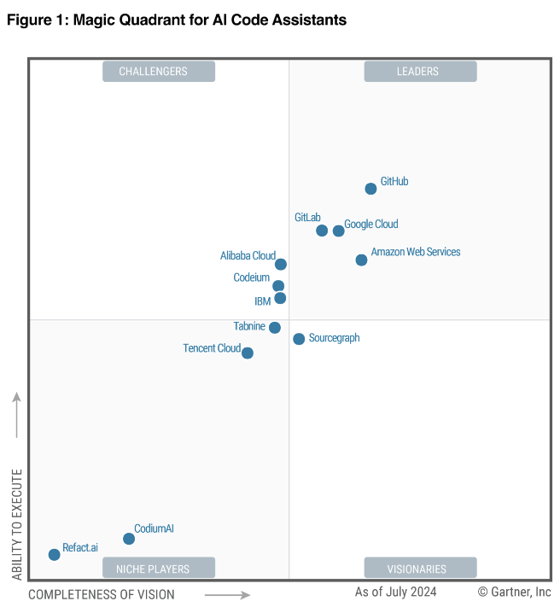
PRODUCTIVITY GAIN ANALYSIS
Internal Slide
Gartner Magic Quadrant for
AI Code Assistants
CONCLUSION
# | PROJECT PHASE/ACTIVITY | % GAIN
1 | Discovery Phase – Architecture, Design, PoC | 5 – 10
2 | Functional Stream – User Story Prep, Workshops, PoC | 5 – 15
3 | Technical Design – Design, PoC | 10 – 15
4 | Build + Unit Test | 10 - 25
5 | Test Case Preparation, Test Data Setup | 25 – 35
6 | Testing | 10 - 15
7 | Deployment | -
8 | Hypercare | -
# | PYRAMID & OFFSHORE | % GAIN
1 | Optimized pyramid, higher Grade A | 10 – 15
2 | Optimized Onshore & Offshore Mix | 5 – 10
Overall Productivity Gains up to 20 %
Note: The above depiction can only be used with the approval of the Business Finance Manager, MU Head, or BU Head with the group guidelines as published. Percentage savings differ from project to project.

